Slide 1
Smart Police
Team 14:
PRANITHA SAROJ KARUMANCHI - 24​
GULNOZA KHAKIMOVA - 28​
SUSHMASRI SURAPANENI - 48​
SAI KALYAN VYTLA - 56​

Slide 2
Motivation
The goal of this project is to create an application which will help police and owners to find stolen cars by scanning license plates.​
Applicating has two modes:​
Online – scans license plate number and return whether vehicle was stolen or not​
Offline – camera snaps photo of the person in the car and compares it with owner of the car.​
Then, finally, it is reported to the user, which makes they live more secure. ​
​

Slide 3
Technologies used
Android and Web Application
Mobile application helps to find stolen cars and report if suspicious person in the car. Web application is used to report if your car has been stolen.
Azure Cognitive Services
Face API is used to verify that person in the car is owner of the vehicle.
Twillio
User gets message notification when stolen car is noticed
OpenAL API
Performs license plate scanning to get plate number, color of the vehicle, make etc.
Firebase, Mongo DB
Database to store data and perform authentication,
Heroku
Deployed endpoints to Heroku to be able to access Databases and Twillio

Slide 4
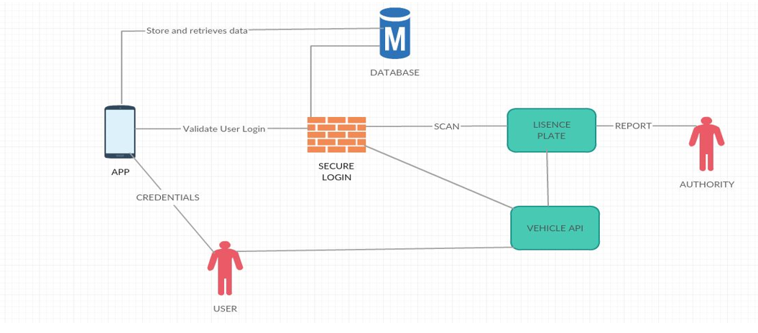
Architecture

Slide 5
Application Modes
Online
Snaps a photo of license plate performs scanning to get plate number, color of the vehicle, plate state, make of the vehicle and year. If stolen car is noticed, owner gets notified.
Offline
Snaps photo of the person in the car and image gets compared against image of the owner and family member, if identity is less than 70% owner and family member gets notification.

Slide 6
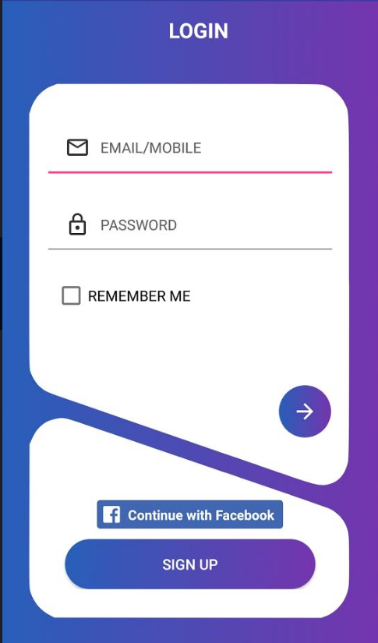
Login Page
User can sign up if he does not have an account yet, also Facebook can be used to login.
Place your screenshot here

Slide 7
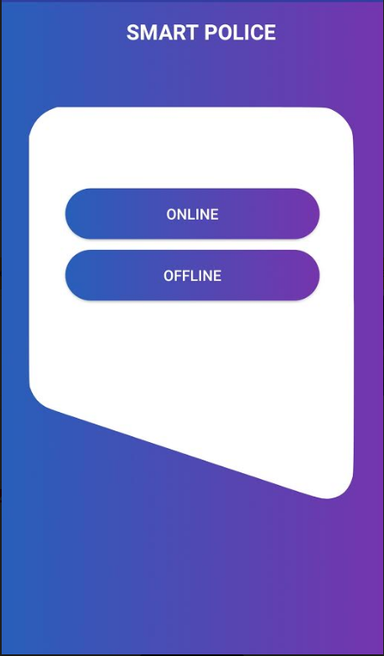
Main Page
Application has two modes: Online and Offline
Place your screenshot here

Slide 8
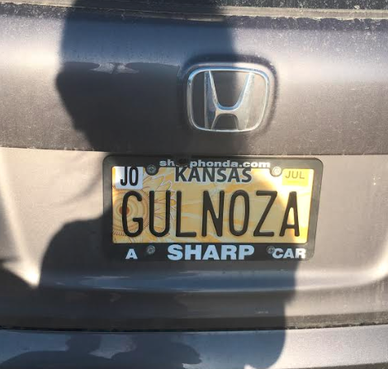
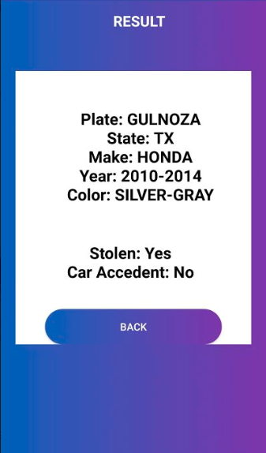
Place your screenshot here
Online Mode
Stolen car was noticed by application which also returns additional information about the car

Slide 9
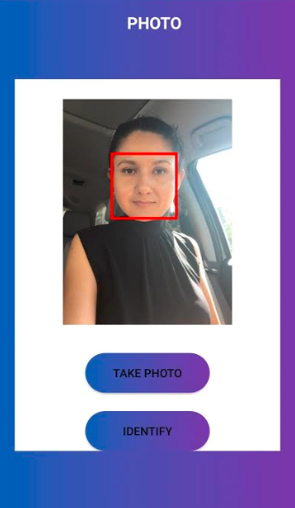
Place your screenshot here
Offline Mode
Person was noticed in the car and application performed face recognition

Slide 10
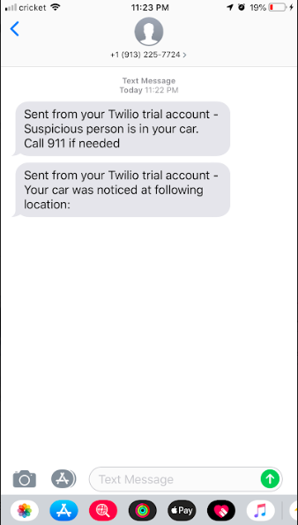
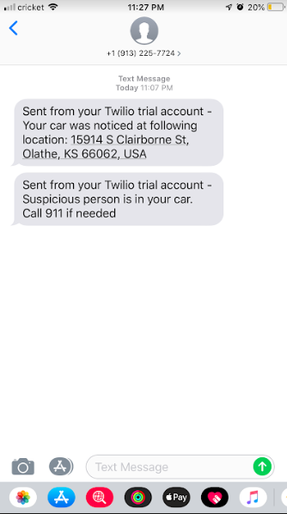
Place your screenshot here
Notification by message
User gets notified when his car noticed or person in the car is not owner.

Slide 11
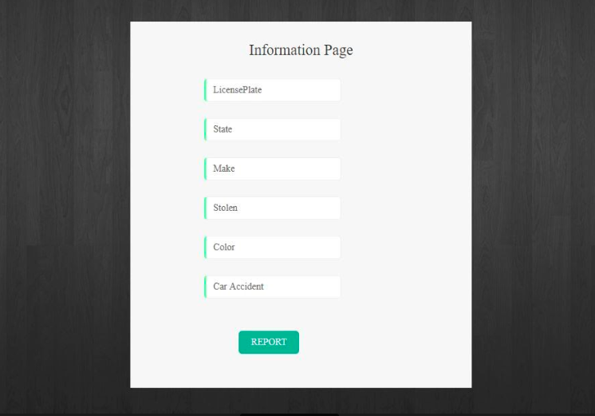
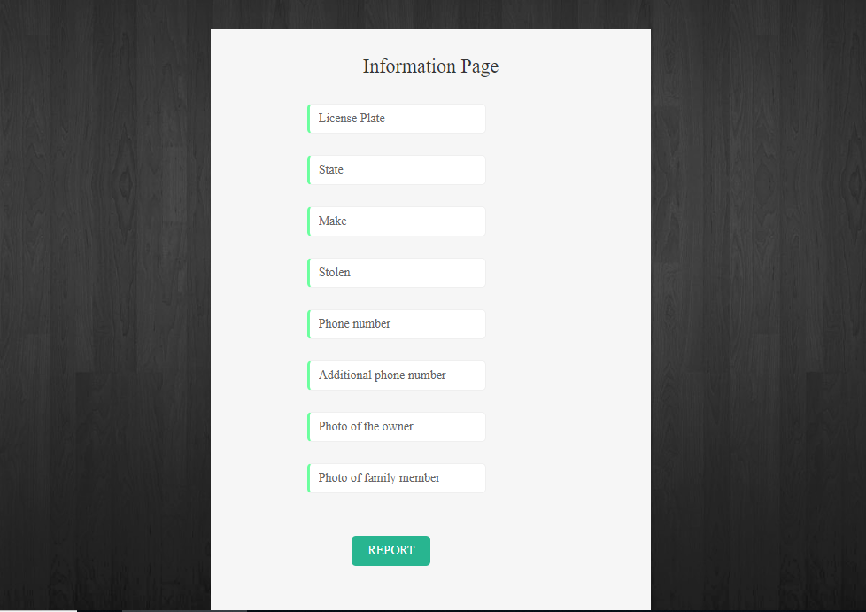
Place your screenshot here
Web Application
Publicly available web application from where users can mark their cars as stolen.

Slide 12
Thanks!
Any questions?
Video: Smart Police Demo

